Slide 1
Hearts and Paws
Entity Relationship Diagram

Slide 2
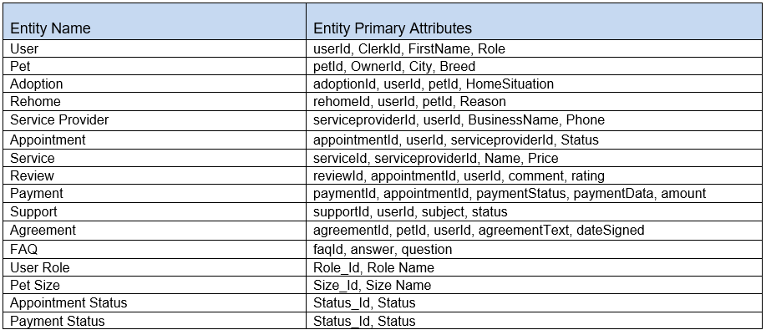
List of Entities

Slide 3
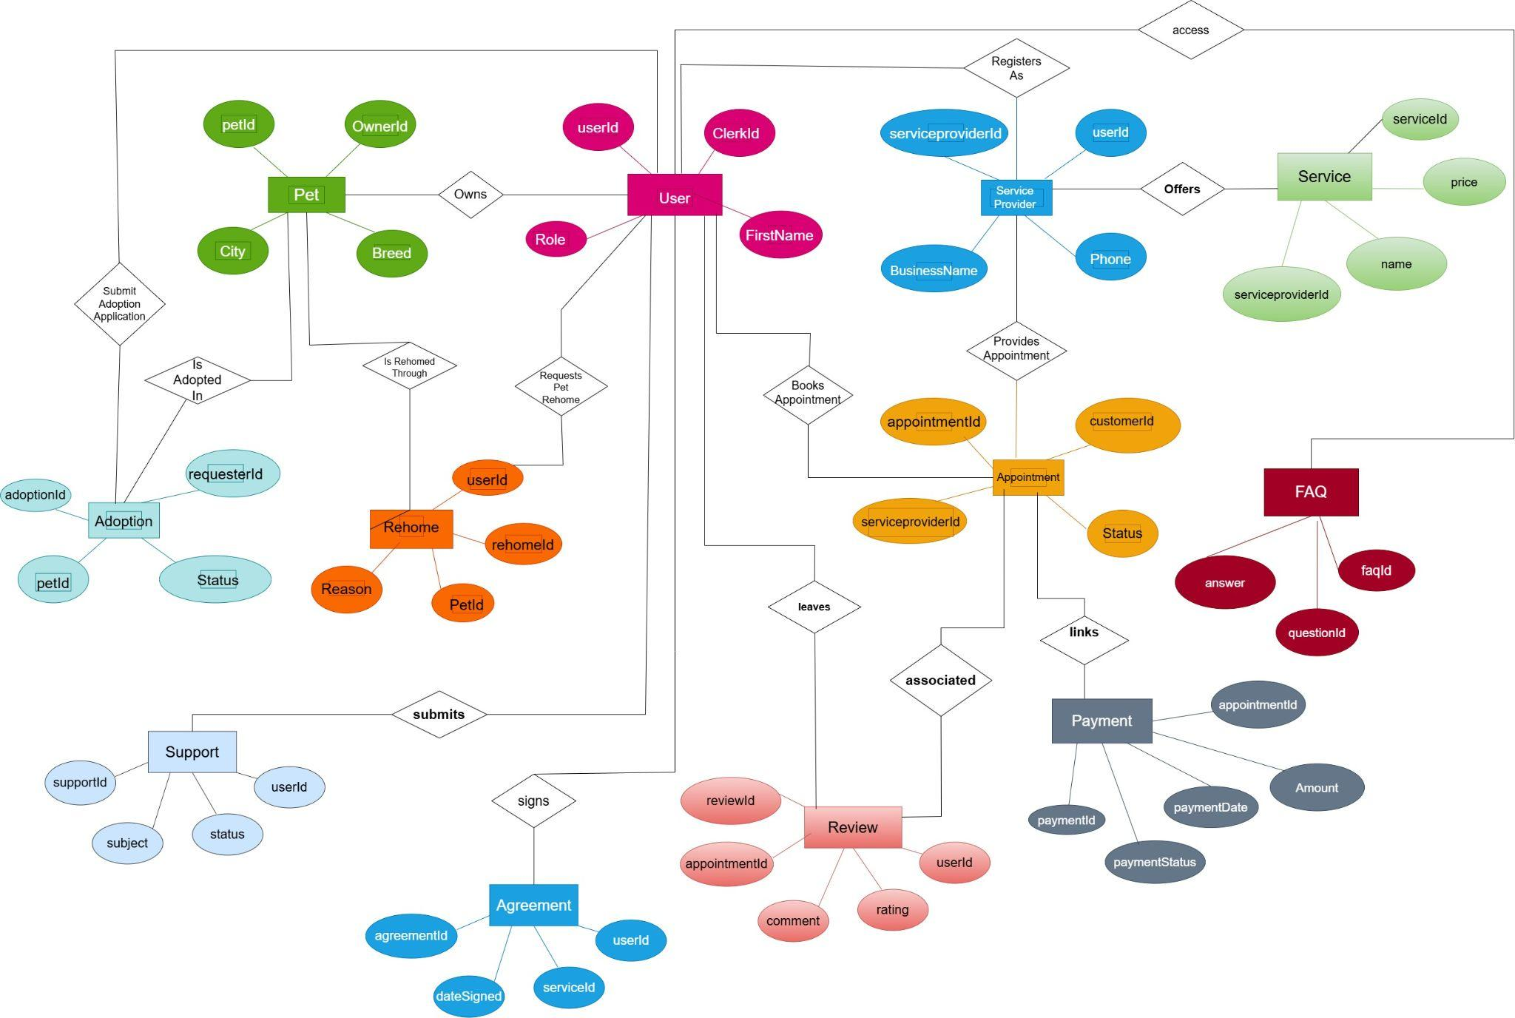
Conceptual ER Diagram: Hearts & Paws

Slide 4
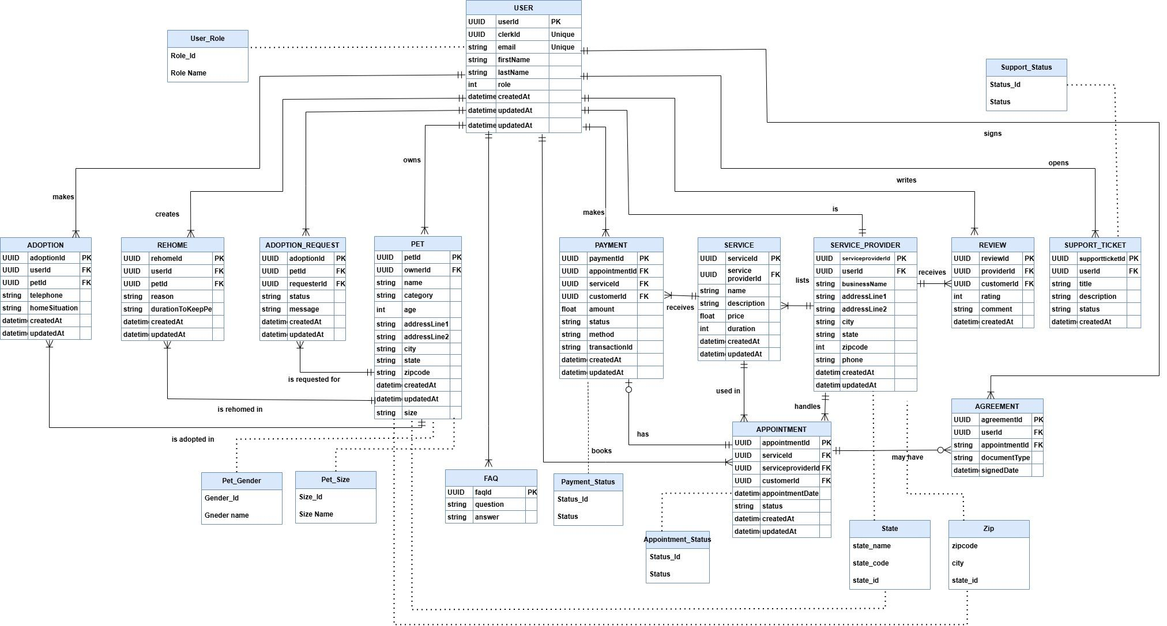
Logical ER Diagram: Hearts & Paws

